Slide 1

NCCoC Quarterly Meeting Fayetteville November 2017
NCCoC Membership Program Update
Purpose:
Membership Status
Membership Awards
Issues and Concerns

Slide 2

NC Council of Chapters based on dues paid
 | NC Council MOAA Membership
 |  | 2016 | 2017
NC01 | Cape Fear | 242 | 254
NC02 | Coastal Carolina | 74 | 67
NC03 | Eastern Carolina | 28
NC04 | Charlotte-Metrolina | 104 | 82
NC06 | Sandhills | 246 | 275
NC07 | Southeastern Carolina | 205 | 248
NC08 | Tarheel Central | 86 | 86
NC09 | Triangle | 122 | 122
NC10 | Western Carolina | 210 | 204
NC11 | Catawba Valley | 46 | 42
NC12 | Durham-Orange | 24 | 28
NC14 | Lloyd A. Osborne Piedmont | 25 | 38
NC17 | First Flight | 24 | 23
NC20 | Central Carolina | 73 | 68
NC21 | High Country | 57 | 58
NC22 | New River | 31 | 32
 |  | 1597 | 1627
Notes:
NC01 Cape Fear 254 NC02 Coastal Carolina 67 NC04 Charlotte-Metrolina 82 NC12 Durham-Orange 28 NC20 Central Carolina 68 NC21 High Country 58 NC22 New River 32

Slide 3

Membership Awards 2016
Do we want to continue the streamer Membership Award?

Slide 4

Members Reported to MOAA
NC01 | Cape Fear | 7 | 5
NC02 | Coastal Carolina | 2 | 2
NC03 | Eastern Carolina | No Report | No Report
NC04 | Charlotte-Metrolina | 11 | 5
NC06 | Sandhills | No Report | No Report
NC07 | SE N Carolina | 27 | 21
NC08 | Tarheel Central | 10 | 4
NC09 | Triangle | No Report | No Report
NC10 | Western Carolina | 8 | 6
NC11 | Catawba Valley | No Report | No Report
NC12 | Durham-Orange | No Report | No Report
NC14 | LA Osborne Piedmont | No Report | No Report
NC17 | First Flight | 2 | 2
NC20 | Central Carolina | 3 | 0
NC21 | High Country | 1 | 1
NC22 | New River | 1 | 1
 | TOTALS | 72 | 47
EASY REPORT TO COMPLETE

Slide 5

MOAA Membership Reporting
MOAA Web Site
Chapters and Councils (Left Top)
Report a New Chapter Member (Scroll Down to Bottom)
Page opens as a fill in form

Slide 7
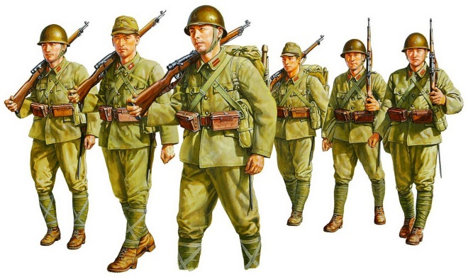
What are Membership Issues?
Recruiting Enthusiasm
Recruiting Younger Officers
Leadership Succession
Purging Rolls
MOAA National Reporting
MOAA National Membership Lists

Slide 8

Questions?

Slide 9
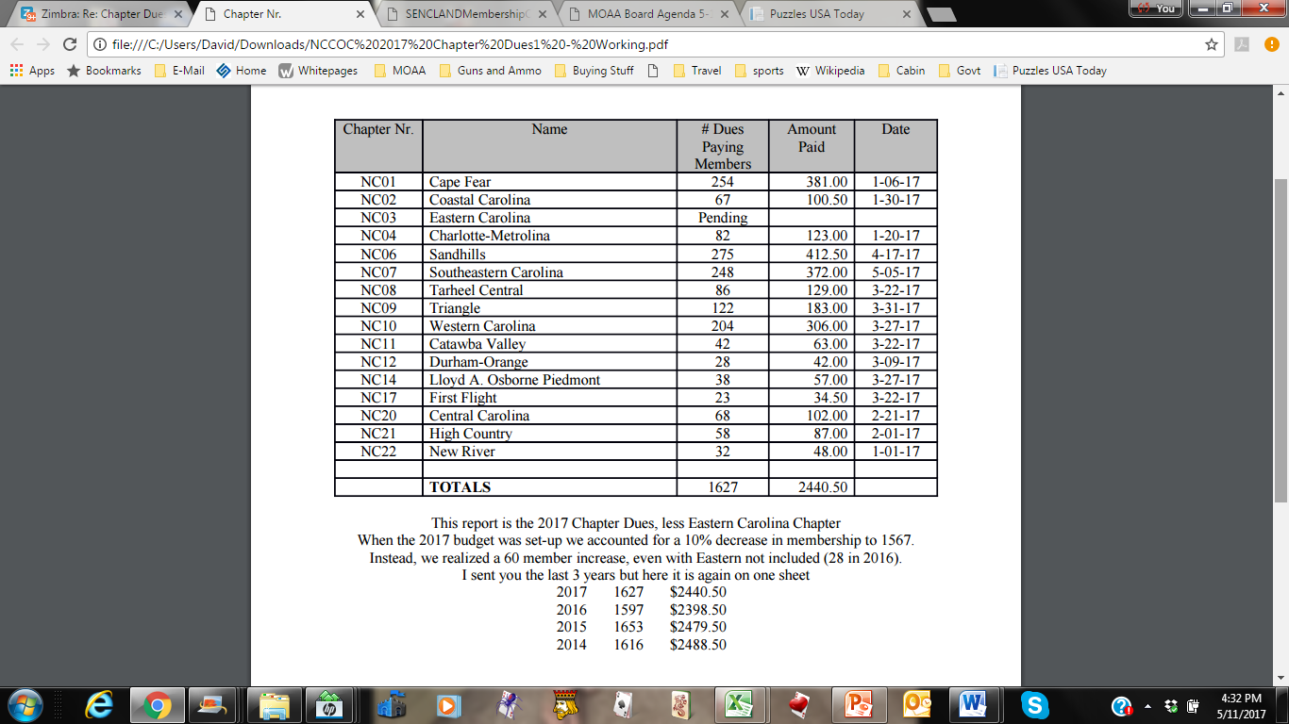
2017 Chapter Dues

